Slide 1
MC311 Requests Analysis
Han Le

Slide 2
Datasets and Ingestion
Ingestion
SQL for selecting service areas and zip codes
Date formats for MC311 data changed to match Weather data
“response_time” variable created
“avg_temp” variable created
Merged MC311 and Weather
Filtered/selected to chosen 5 zip codes for Zip Code data
Renamed variable names for readability for all
MC311 Requests
Variables such as opened/closed date, area of service, zip code
Source: dataMontgomery
Maryland Weather Summaries
Variables such as date recorded, max/min temperature, precipitation
Source: National Oceanic and Atmospheric Administration (NOAA)
Maryland Census Data
Variables are population characteristics by ZIP code
Source: Maryland.gov

Slide 3
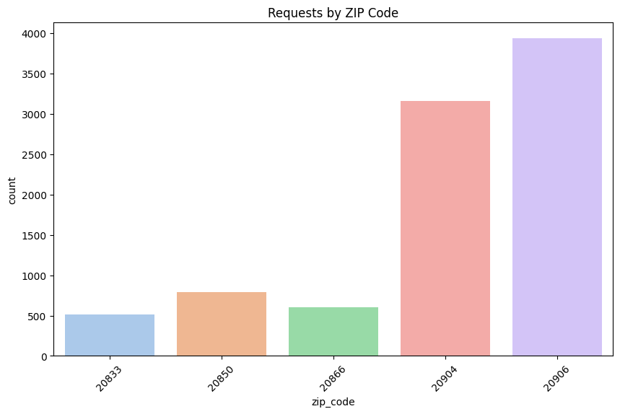
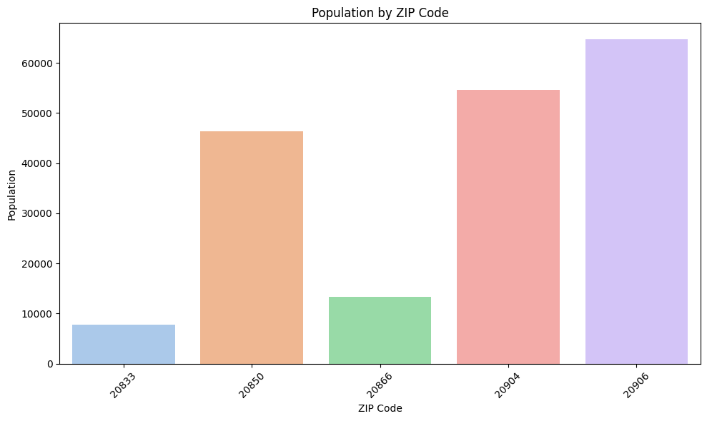

Slide 4
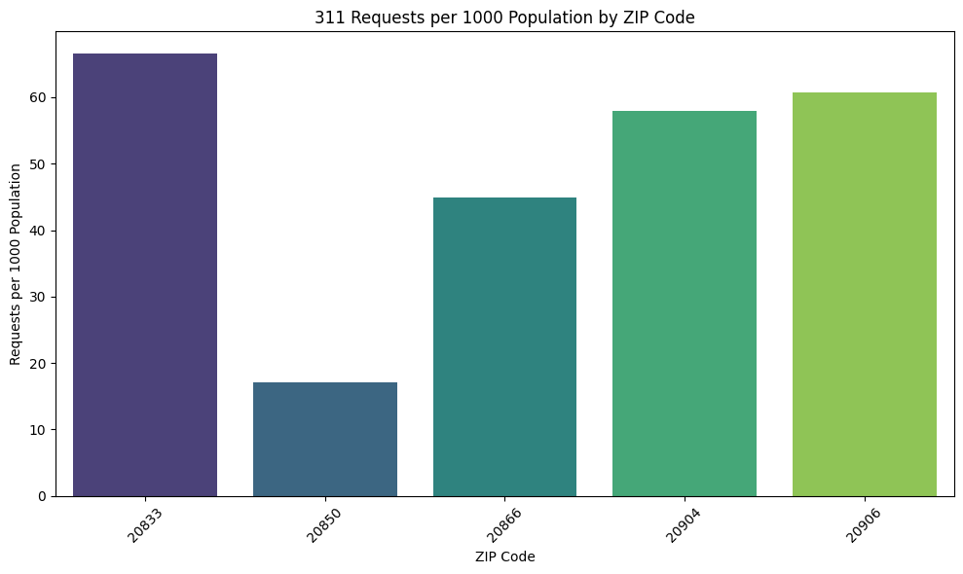

Slide 5
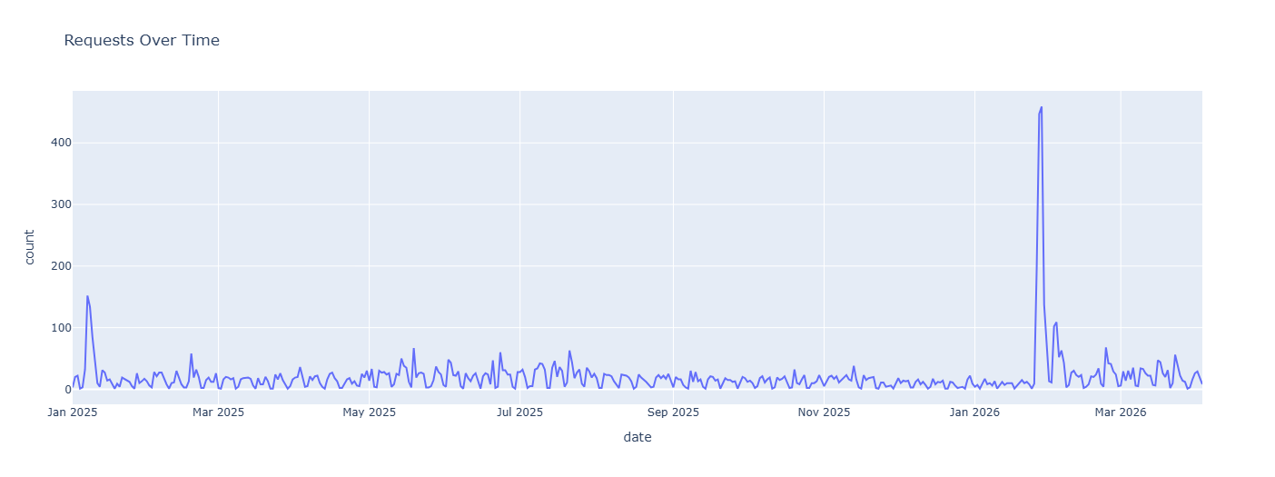

Slide 6
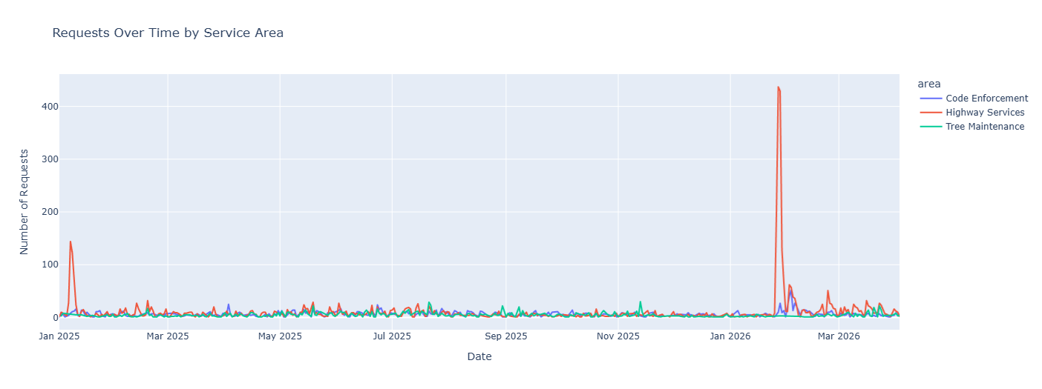

Slide 7
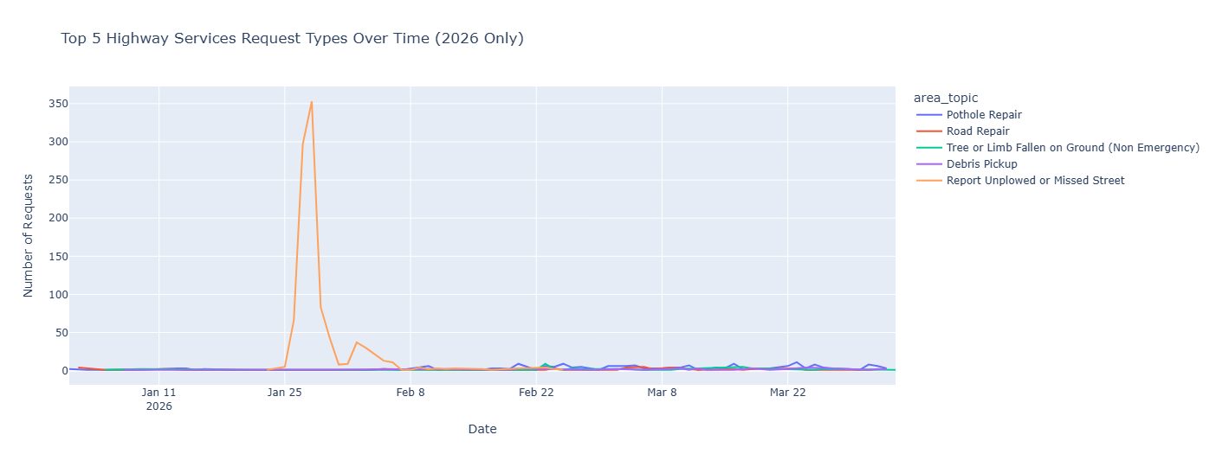

Slide 8
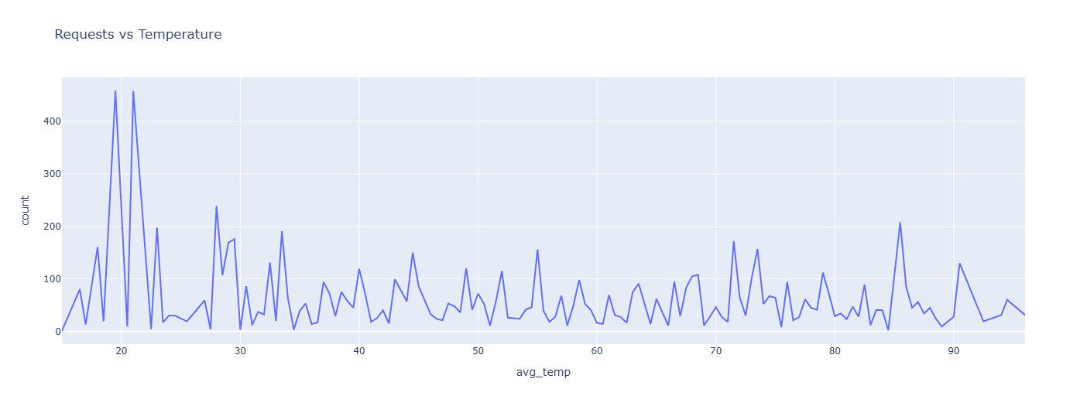

Slide 9
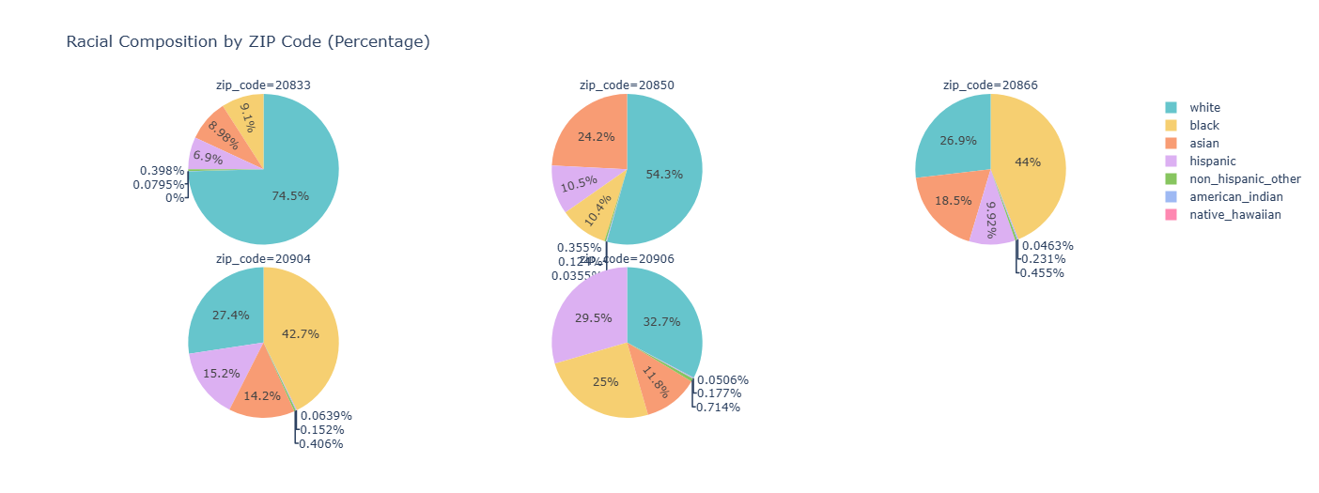

Slide 10
Next Steps
Examine relationships between variables with correlation analysis
Strength and direction of relationships weather vs. demand, etc.
Analyze weather impact with linear regression
Evaluate socioeconomic effects using multiple regression
Housing characteristics, racial compositions and age relation to demand across ZIP codes
Model SLA outcomes using logistic regression
Examine factors affecting whether requests meet SLA (Yes/No)

